Slide 1
Java Performance Tuning

Slide 2
Optimization – Why?
Getting Java apps to run is one thing. But getting them to run faster and achieving SLA is another challenge.
Achieving best Performance is a tricky, especially in object-oriented environment, but the complexity of the JVM and Garbage Collection makes it more challenging.
Lets first understand architecture of JVM, Memory Snapshot, Garbage Collector, and further explore how we can tune them, to achieve better performance.

Slide 3
JVM Internal Architecture
Java bytecode runs in a JRE (Java Runtime Environment). The most important element of the JRE is Java Virtual Machine (JVM), which analyzes and executes Java byte code.
Understanding internal architecture of JVM helps to write better Java Code, and helps in Performance Profiling and Tuning.
VM (Java Virtual Machine) is an abstract machine, whose instruction set is byte code. It is a specification that provides runtime environment in which java bytecode can be executed.
JVMs are available for many hardware and software platforms, hence JVM is Platform Dependent.
JVMs are generally developed in C/C++.(TBD: List all JVMs in market)

Slide 4
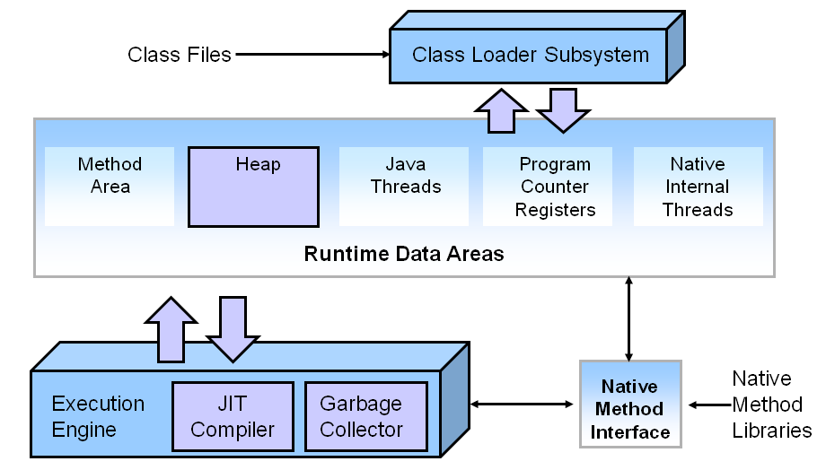
JVM Key Components

Slide 5
JVM Internal Architecture
Below are components of JVM:
Class Loader
Byte Code Verifier
Execution Engine
Garbage Collector
Security Manager

Slide 6
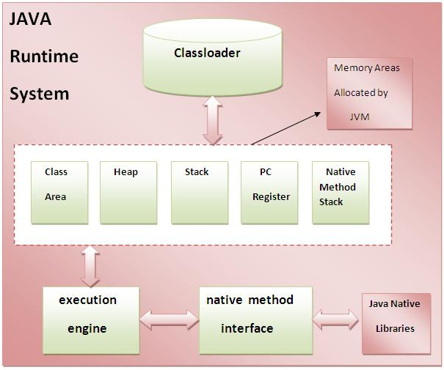
JVM Internal Architecture

Slide 7
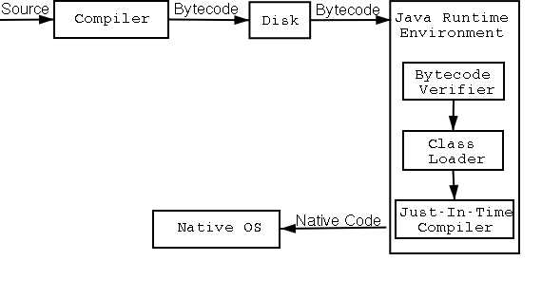
Java Code Compilation and Execution

Slide 8
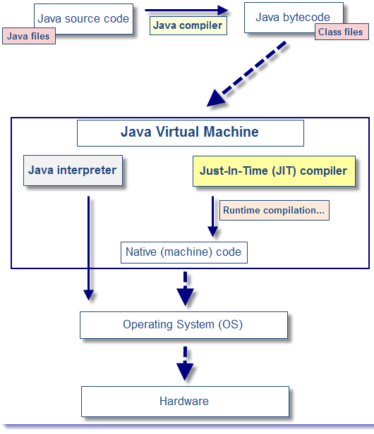
Interpreter and JIT Compiler

Slide 9
JVM Internal Components
ByteCode verifier: ByteCode verifier checks if the read bytecode, is valid, and detects any malicious operations which may corrupt data/code.
Classloader: Classloader is a subsystem of JVM that is used to load required class files(compiled byte code of each class file)
Class(Method) Area: Class(Method) Area stores per-class structures such as the runtime constant pool, field and method data, the code for methods.
Heap: It is the runtime data area in which objects are allocated.
Stack: Java Stack stores frames. It holds local variables and partial results, and plays a part in method invocation and return.

Slide 10
JVM Internal Architecture
Each thread has a private JVM stack, created at the same time as thread.
A new frame is created each time a method is invoked.
A frame is destroyed when its method returns.
Program Counter Register: PC (program counter) register. It contains the address of the Java virtual machine instruction currently being executed.
Native Method Stack: It contains all the native methods used in the application.

Slide 11
Execution Engine: Interpreter & JIT Compiler
The bytecode that is loaded using class loader is executed by the execution engine.
Then the execution engine changes the Java bytecode to the native machine language. The bytecode can be changed to the native machine language in one of two ways.
Interpreter: Reads, interprets and executes the bytecode instructions one by one. As it interprets and executes instructions one by one, it can quickly interpret one bytecode, but slowly executes the interpreted result.
JIT (Just-In-Time) compiler: The JIT compiler overcomes disadvantages of the interpreter. JIT compiler compiles the entire bytecode to change it to native code. Frequently invoked Nativecode is stored in cached, and retrieved from cache whenever required, rather than interpreting it again and again, which makes overall execution faster.
Either of above can be used, based on whether same code need to be executed again and again.

Slide 12
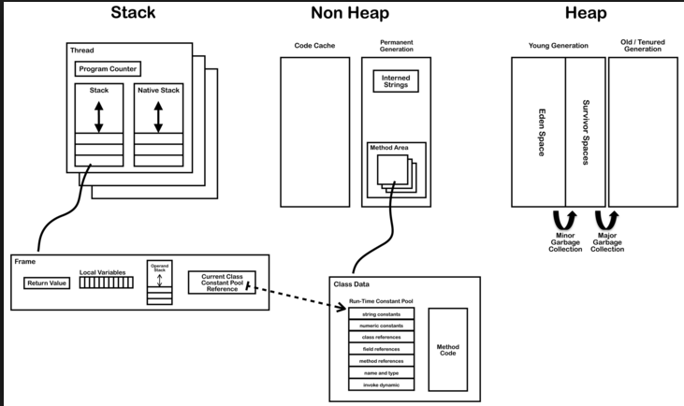
Program under Execution in JVM

Slide 13
Reasons for Performance Problems
Excessive Logging
Excess Memory usage
Thread Synchronization/DeadLock
Improper Optimization
Improper Design/Coding due to poor understanding of Concepts like GC.
ItemStock[] stocks = catalogSessionBean.loadAllStocks(); for (ItemStock stock : stocks) { if (stock.getProductId().getId()==id) { if(catalogSessionBean.updateStock(stock,-1)){ basketBean.addToBasket(id); . . . } . . . }

Slide 14
Reasons for Performance Problems
Improper Interaction with database:
Do not interact with database very frequently
Limit the number of records fetched(For eg. Using stmt.setFetchSize(100); )
Use indexing

Slide 15
How To Improve Performance
Understanding JVM Internals
Memory Model
Working of Garbage Collector
Various Garbage Collector Algorithms
Tuning Garbage Collector
Monitor Heap, GC, Lock Contention using various Tools
Tuning Memory Allocations
Tuning JIT Compiler
Understanding Lock Contention

Slide 16
Role of Garbage Collector
As known Memory can be allocated and de allocated from Heap, when the Program is under execution.
Such Heap Memory de allocation need to be performed by Programmer in Programming Languages such as C/C++, failing which Memory Leak occurs.
However in Java we are relieved from destroying unreferenced objects, as Garbage Collector, automatically performs this.
However, this Garbage Collection causes Performance Hit. Hence Garbage Collection need to be understood, and tuned to avoid or control Performance issues.

Slide 17
Role of Garbage Collector…
Garbage Collection Tuning plays vital role especially in Long Running or memory Intensive Applications

Slide 18

What Garbage Collection actually does?
One of the basic way of garbage collection involves three steps:
Marking: This is the first step where garbage collector identifies which objects are in use and which ones are not in use.

Slide 19
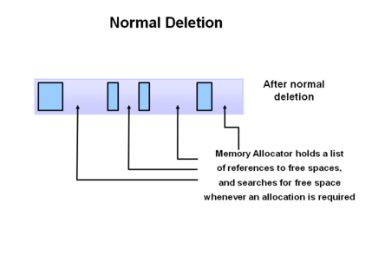
What Garbage Collection actually does?
Normal Deletion: Garbage Collector removes the unused objects and reclaim the free space to be allocated to other objects.

Slide 20
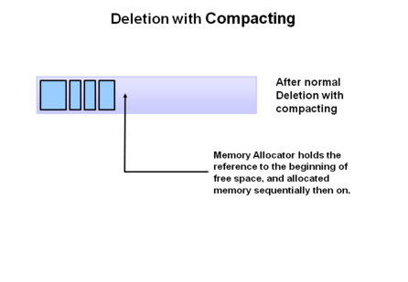
What Garbage Collection actually does?
Deletion with Compacting: For better performance, after deleting unused objects, all the survived objects can be moved to be together. This will increase the performance of allocation of memory to newer objects.

Slide 21
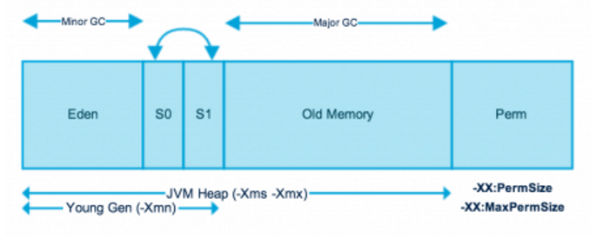
JVM – Heap Memory Model
Understanding Memory structure is very important to get insight on working of Garbage Collector.
And Tuning Garbage Collector plays important role in controlling memory and performance aspects of a Java Application.
Java(JVM) Memory Model

Slide 22
Heap Memory Model – In Depth
At broad level, JVM Heap memory is divided into two parts
Young Generation
Old Generation.
Young Generation:
Young generation is the place where all the new objects are created.
When young generation is filled, garbage collection is performed.
This garbage collection is called Minor GC.
Young Generation is further divided into three parts – Eden Memory and two Survivor Memory spaces.

Slide 23
Young Generation Memory
Important Points about Young Generation Spaces:
Most of the newly created objects are located in the Eden memory space.
When Eden space is filled with objects, Minor GC is performed and all the survivor objects are moved to one of the survivor spaces.
Minor GC also checks the survivor objects and move them to the other survivor space. So at a time, one of the survivor space is always empty.
Objects that are survived after many cycles of GC, are moved to the Old generation memory space. Usually it’s done by setting a threshold for the age of the young generation objects before they become eligible to promote to Old generation.

Slide 24
Old Generation Memory
Old Generation memory contains the objects that are long lived and survived after many rounds of Minor GC.
Usually garbage collection is performed in Old Generation memory when it’s full.
Old Generation Garbage Collection is called Major GC and generally takes longer time.

Slide 25
Garbage Collector Stops Java Apps
All the Garbage Collections are “Stop The World” (referred as STW) events because all application threads are stopped until the operation completes.
Since Young generation keeps short-lived objects, Minor GC is very fast and the application doesn’t get much affected by this.
However Major GC takes longer time because it checks all the live objects.
Major GC should be minimized because it will make your application unresponsive for the garbage collection duration.
For a responsive application and with lot of Major Garbage Collection happening, you will notice timeout errors, and it may effect overall SLA.

Slide 26
Garbage Collector Stops Java Apps
The duration taken by garbage collector depends on the strategy used for garbage collection.
Hence garbage collector tuning is required to avoid timeouts in the highly responsive applications.
How Garbage Collector Helps us? Does Garbage Collection hits performance of Java Application?
In which Java Applications garbage Collection plays important Role? In long running Applications or Applications using huge heap memory.
So, for the Java App to be more responsive, this stop/pause need to be as brief as possible.

Slide 27
jcmd

Slide 28
Memory Model – Permanent Generation
Permanent Generation or “Perm Gen” contains the application metadata required by the JVM to describe the classes and methods used in the application.
Perm Gen is not part of Java Heap memory.
Perm Gen is populated by JVM at runtime based on the classes used by the application.
Perm Gen also contains Java SE library classes and methods.
Perm Gen objects are garbage collected in a full garbage collection.

Slide 29
Memory Model – Permanent Generation
Java Memory Model – Method Area
Method Area is part of space in the Perm Gen and used to store class structure (runtime constants and static variables) and code for methods and constructors.
Java Memory Model – Memory Pool
Memory Pools are created by JVM memory managers to create a pool of immutable objects, if implementation supports it. String Pool is a good example of this kind of memory pool. Memory Pool can belong to Heap or Perm Gen.
Java Memory Model – Runtime Constant Pool
Runtime constant pool is per-class runtime representation of constant pool in a class. It contains class runtime constants and static methods. Runtime constant pool is the part of method area.
Java Memory Model – Java Stack Memory
Java Stack memory is used for execution of a thread. They contain method specific values that are short-lived and references to other objects in the heap that are getting referred from the method.

Slide 30
What Garbage Collection actually does?
Identifying and remove the unused objects from the memory and free space to be allocated to objects created in the future processing.
One of the best feature of java programming language is the automatic garbage collection, in C/C++ such Heap memory need to be manually deleted or freed, and when such freeing is not done or improperly done, results in memory Leak.
Garbage Collector is the program running in the background that looks into all the objects in the memory and find out objects that are not referenced by any part of the program.
All unreferenced objects are deleted and space is reclaimed for allocation to other objects.

Slide 31
List of Tools to Monitor and Tune performance
Command Line based Tools
Jstat
Jstatd
Jps
Jconsole
Java
Jmap – to get Heap dump
Jstack – to get Thread dump
Jhat – Usage jhat dump.hprof
GUI Based Tools
VisualVM
VisualGC
Eclipse MAT

Slide 32
Latency , Throughput and Footprint
Latency/Pause Time: This is how long the application pauses/appears unresponsive because of garbage collection. Better to consider both maximum pause time, and various statistics like average and standard deviation. This time need to be minimum, for the Application, to be responsive.
Throughput: This is the percentage of total time not spent in garbage collection considered over long periods of time. If application spends 10% of its time in garbage collection the throughput is 90%. For application, to perform as many calculations as possible, need to tune the garbage collection to maximize throughput.
FootPrint: How memory is used by the JVM when running Application.

Slide 33
Garbage Collector Algorithms
Serial Collector:
Serial collector is the simplest one, and the one not being used, as it’s mainly designed and works best for single-threaded environments (e.g. 32 bit or Windows) and for small heaps( <100MB).
This collector freezes all application threads whenever it’s working, which disqualifies it for all intents and purposes from being used in a server environment.
It can be enabled by using -XX:+UseSerialGC JVM argument.
Parallel/Through Put Collector:
Parallel collector is the JVM’s default collector. Much like its name, its biggest advantage is that is uses multiple threads to scan through and compact the heap.
The downside to the parallel collector is that it will stop application threads when performing either a minor or full GC collection.
The parallel collector is best suited for apps that can tolerate application pauses and are trying to optimize for lower CPU overhead caused by the collector.
It can be enabled using -XX:+UseParallelGC

Slide 34
Garbage Collector Algorithms
CMS Collector: CMS collector (“ concurrent-mark-sweep”) algorithm uses multiple threads (“concurrent”) to scan through the heap (“mark”) for unused objects that can be recycled (“sweep”).
This algorithm will enter “stop the world” (STW) mode in two cases: when initializing the initial marking of roots (objects in the old generation that are reachable from thread entry points or static variables) and when the application has changed the state of the heap while the algorithm was running concurrently, forcing it to go back and do some final touches to make sure it has the right objects marked.
Heap should be less than 4Gb in size. -XX:+UseParNewGC

Slide 35
Garbage Collector Algorithms
Garbage First Collector:
Garbage first collector (G1) introduced in JDK 7 update 4 was designed to better support heaps larger than 4GB.
The G1 collector utilizes multiple background threads to scan through the heap that it divides into regions, spanning from 1MB to 32MB (depending on the size of your heap).
G1 collector is geared towards scanning those regions that contain the most garbage objects first, giving it its name (Garbage first).
This collector is turned on using the –XX:+UseG1GC flag.

Slide 36
Garbage Collector Algorithms
Java 8 and the G1 Collector:
This optimization was added with Java 8 update 20 for is the G1 Collector
String deduplication.
Since strings (and their internal char[] arrays) takes much of our heap, a new optimization has been made that enables the G1 collector to identify strings which are duplicated more than once across your heap and correct them to point into the same internal char[] array.
This avoids multiple copies of the same string from residing inefficiently within the heap.
To enable use the option -XX:+UseStringDeduplication

Slide 37
Which gc algorithm to use?
GC Algorithm Name | When to use?
Serial Collector | Single Threaded/Single Processor, desktop based Apps, with minimal data(Heap <100MB). Apps are fine with Pauses
Parallel Collector | This Collector is enabled by default, and results in high Throughput
Concurrent Mark Sweep (CMS) Collector | applications that prefer shorter garbage collection pauses
Garbage-First Garbage Collector | server-style collector is for multiprocessor machines with large memories. It meets garbage collection pause time goals with high probability while achieving high throughput.

Slide 38
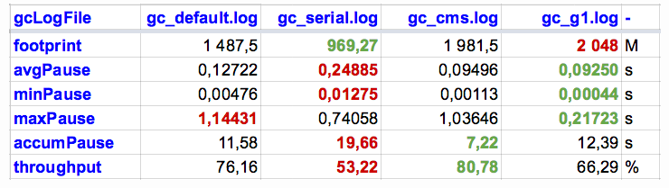
Comparison of GC algorithms

Slide 39
Hotspot JVM Heap Size Options
-XX:NewSize | New generation heap size
-XX:MaxNewSize | maximum size of the New Generation heap size.
-XX:SurvivorRatio | ratio of the Eden/survivor space size. Set to 8 and monitor Garbage Collection
-Xms | intial heap size
-Xmx | maximum size of the heap

Slide 40
Purpose of jps
JPS Java Virtual Machine Process Status Tool, The jps tool lists the instrumented HotSpot Java Virtual Machines (JVMs) on the target system.
It is also possible to get Java Process running on remote machine.
OPTIONS
The jps command supports a number of options that modify the output of the command.
-q Suppress the output of the class name, JAR file name, and arguments passed to the main method, producing only a list of local VM identifiers.
-m Output the arguments passed to the main method. The output may be null for embedded JVMs.
-l Output the full package name for the application's main class.
-vOutput the arguments passed to the JVM.
-VOutput the arguments passed to the JVM through the flags file (the .hotspotrc file or the file specified by the -XX:Flags=<filename> argument).-
For example, -J-Xms48m sets the startup memory to 48 megabytes. It is a common convention for -J to pass options to the underlying VM executing applications written in Java.

Slide 41
How to Check memory Allocation size?
Jstat Tool provided with JDK, is used to find memory allocations for various Heap Memory components or parts.
How to use jstat?
jstat –gc 2367 1000 10
2367 is process id and 1000 prints memory allocation details every 1 second
10 prints the output 10 times

Slide 42
How to read jstat output?
S0C and S1C: This column shows the current size of the Survivor0 and Survivor1 areas in KB.
S0U and S1U: This column shows the current usage of the Survivor0 and Survivor1 areas in KB. Notice that one of the survivor areas are empty all the time.
EC and EU: These columns show the current size and usage of Eden space in KB. Note that EU size is increasing and as soon as it crosses the EC, Minor GC is called and EU size is decreased.
OC and OU: These columns show the current size and current usage of Old generation in KB.
PC and PU: These columns show the current size and current usage of Perm Gen in KB.

Slide 43
How to read jstat output?
YGC and YGCT: YGC column displays the number of GC event occurred in young generation. YGCT column displays the accumulated time for GC operations for Young generation. Notice that both of them are increased in the same row where EU value is dropped because of minor GC.
FGC and FGCT: FGC column displays the number of Full GC event occurred. FGCT column displays the accumulated time for Full GC operations. Notice that Full GC time is too high when compared to young generation GC timings.
GCT: This column displays the total accumulated time for GC operations. Notice that it’s sum of YGCT and FGCT column values.

Slide 44
How to use JMAP command
Usage
jmap -dump:live,file=<file-path> <pid>
where pid: is the Java Process Id, whose heap dump should be captured
file-path: is the file path where heap dump will be written in to.
Example:
jmap -dump:live,file=D:/AddressBook-heapdump.bin 37320

Slide 45
VisualVM UI Tool
This is UI Tool to Monitor Heap usage, GC, Threads, etc… of any running Java Application.
How to get VisualVM Tool?
Download and install it from
https://visualvm.github.io/download.html

Slide 46
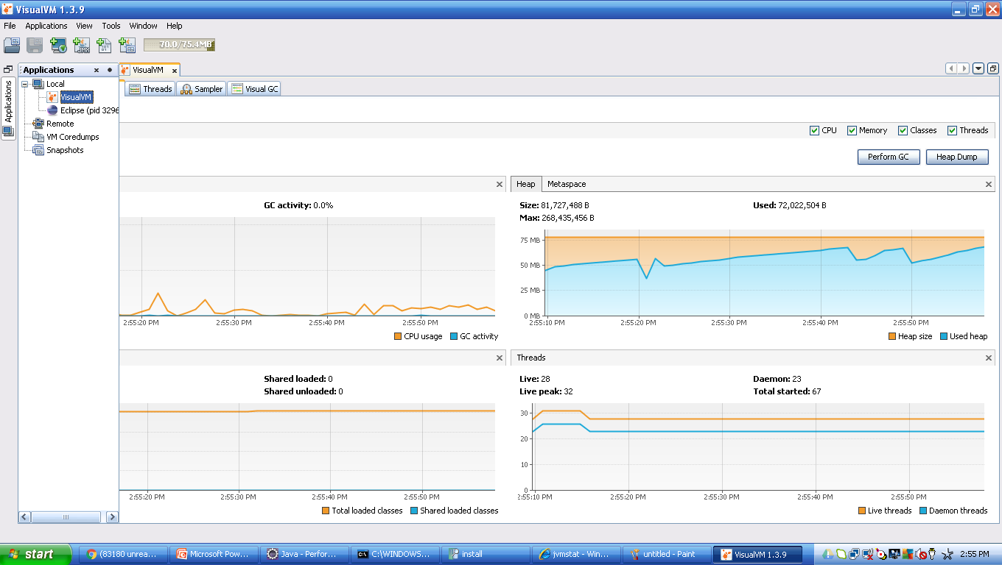
VisualVM UI Tool

Slide 47
VisualGC 2.x UI Tool
VisualGC Tool shows Eden, Survival, PermGen Memory slots, and their current usage details.
This tool is available as Plugin to VisualVM. After installing VisualVM Tool, follow below steps
Select Tools
Select Plugins
Then select VisualGC, and install

Slide 48
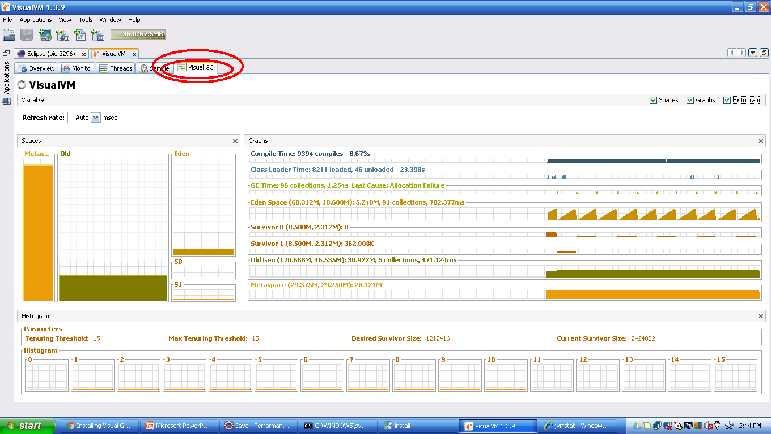
VisualGC 2.x UI Tool

Slide 49
Jconsole Tool
Jconsole Tool provided with JDK, can be used to dump Heap.
This Tool can be launched by typing jconsole in command line
Below are steps to generate HeapDump
On the MBeans tab, in the com.sun.management/HotSpotDiagnostics object, select the Operationsection.
In dumpHeap parameters, enter the following information:p0: [heap-output-path] p1: true - do a garbage collection before dump heap
For example:p0: c:/abc.dmp p1: true
Click the dumpHeap button.

Slide 50
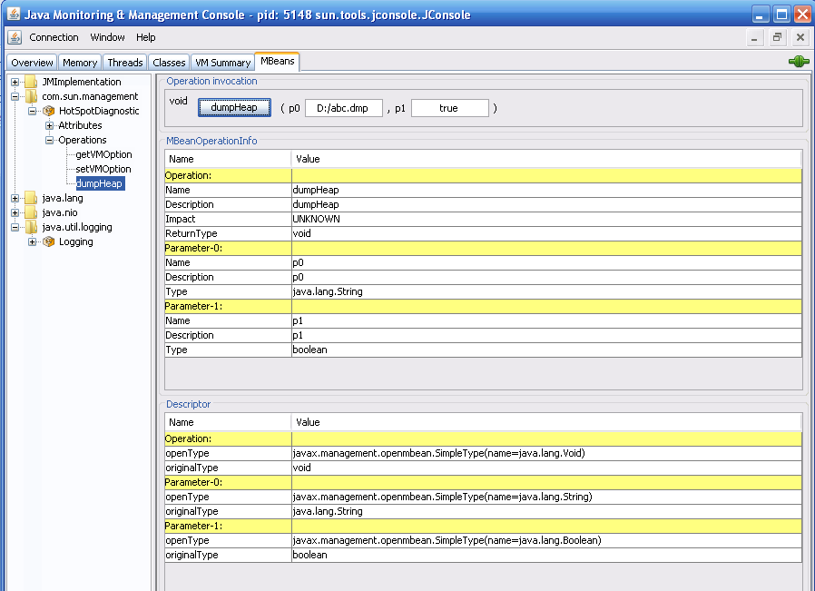
Jconsole Tool Snapshot

Slide 51
Eclipse MAT Tool – Memory Analyzer Tool
Eclipse MAT Tool is used to process and view HeapDump. It even shows minute details like number of instances of an object, etc…
How to install MAT on Eclipse
Eclipse —> Help Menu —> Install New Software —> Add
Enter below information http://download.eclipse.org/mat/1.5/update-site/ and follow onscreen instructions to complete installation of MAT Plugin to you Eclipse IDE.

Slide 52
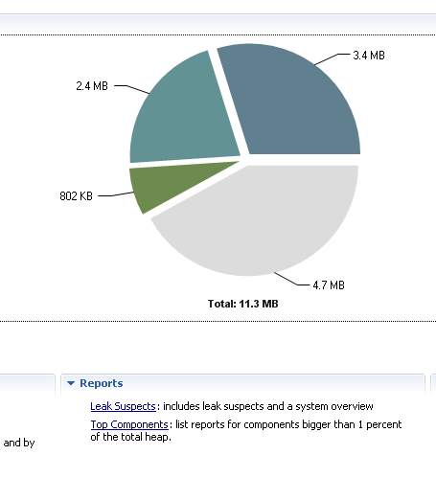
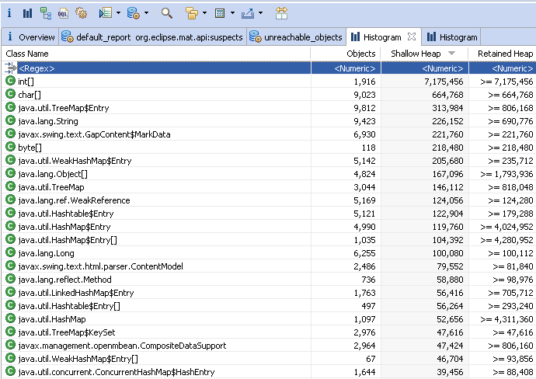
Eclipse MAT Tool Snapshots
Searchable Text

Slide 53
Eclipse MAT Tool – terminology
Dominator Tree: List the biggest objects and what they keep alive.
Shallow size
The shallow size of an object is amount of memory used to store the object itself. The referenced objects are not taken into account.
Retained size
The retained size of an object is the amount of memory that can be freed when the object is collected by the garbage collector.

Slide 54
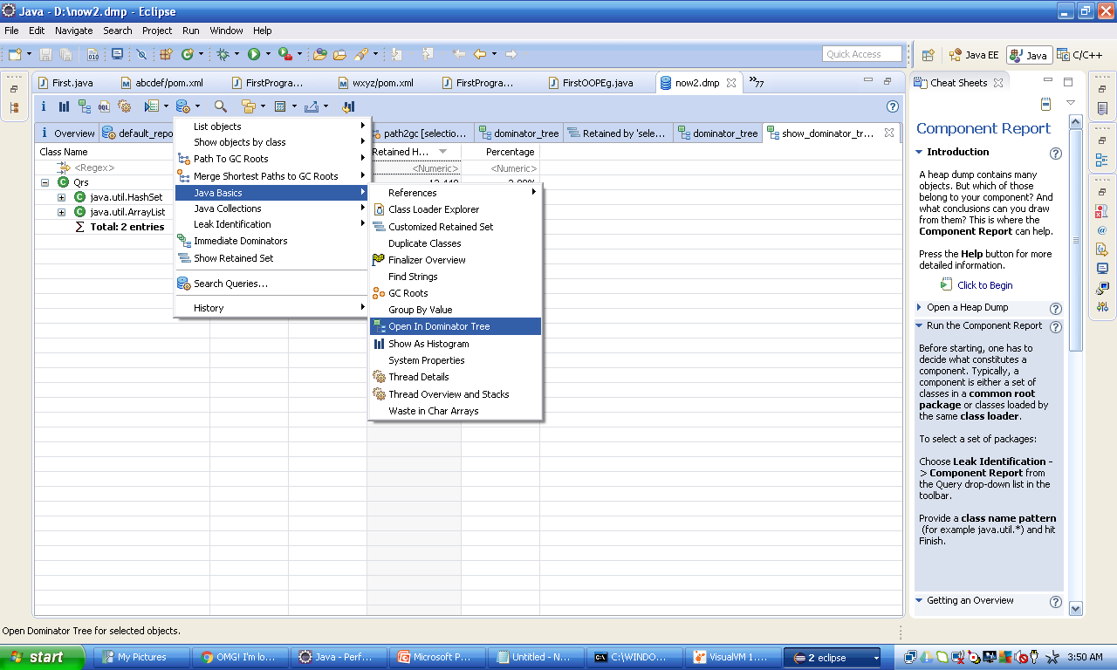
MAT Tool DOMINATOR TREE – view details of a class

Slide 55
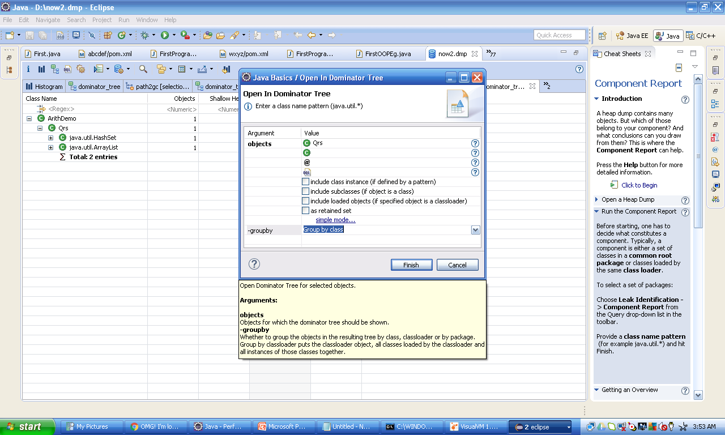
MAT Tool DOMINATOR TREE

Slide 56
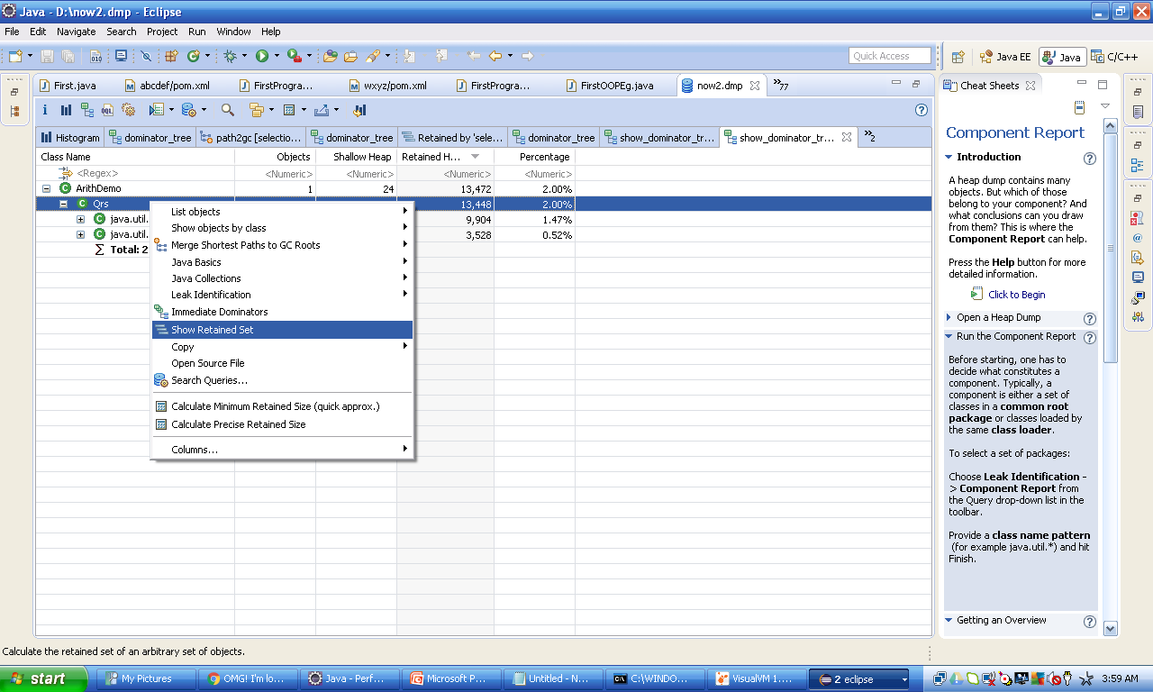
MAT Tool VIEW RETAINED SET

Slide 57
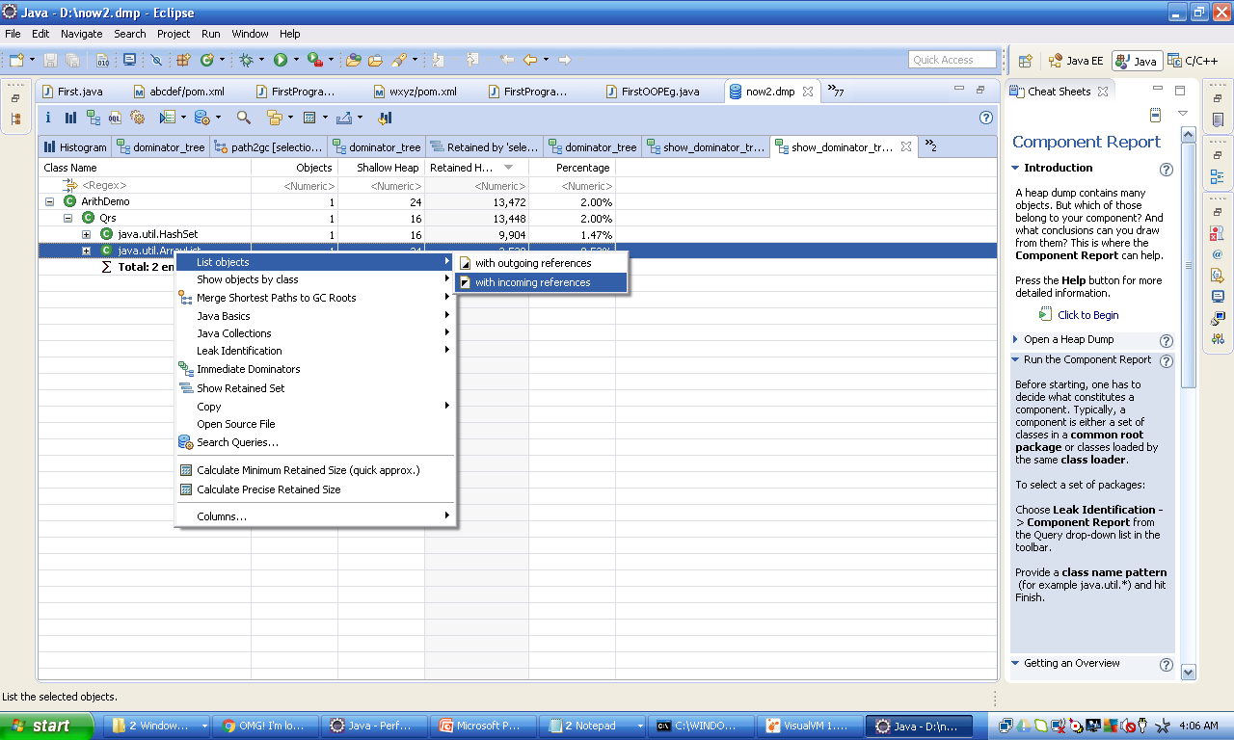
MAT Tool SHOW LARGEST OBJECT OF A TYPE

Slide 58
MAT Tool
Its possible to import the reports in various formats
MAT Supports OQL(Object Query Language): This can be used to query any information from HeapDump.
OQL is like SQL, here classes as tables, objects as rows, and fields as columns
For example: select * from java.lang.String where toString().startsWith(“abc") to query String objects with a certain prefix (i.e., “abc") and calculate the total size of retained heap associated with the interested objects.

Slide 59
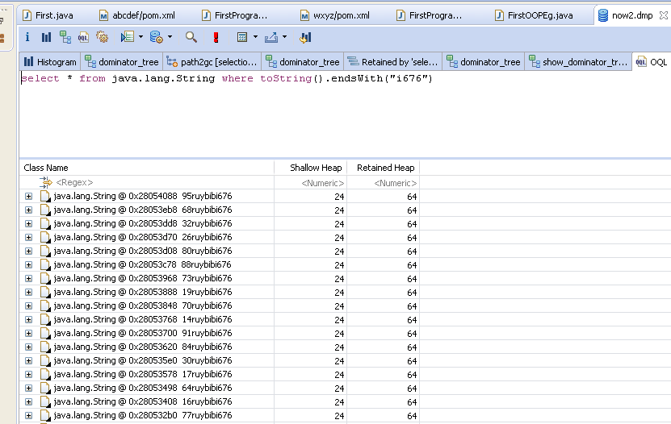
MAT Tool - OQL

Slide 60
MAT Tool – immediate dominators
An Object A is said to dominate an Object B if every path from the Root to B must pass through A
Right click and select “Immediate Dominators”

Slide 61
finalize() method
As known, finalize() method gets invoked, when an object gets Garbage Collected. Hence Garbage Collection of objects with finalize() method is delayed a bit, unlike an object without finalize().
Objects with finalizers (those that have a non-trivial finalize() method) have significant overhead compared to objects without finalizers, and should be used sparingly.
Finalizeable objects are both slower to allocate and slower to collect.

Slide 62
finalize() method
At allocation time, the JVM must register any finalizeable objects with the garbage collector, and (at least in the HotSpot JVM implementation) finalizeable objects must follow a slower allocation path than most other objects.
Similarly, finalizeable objects are slower to collect, too.
It takes at least two garbage collection cycles (in the best case) before a finalizeable object can be reclaimed, and the garbage collector has to do extra work to invoke the finalizer.
Where finalize() is defined? What are other methods defined there?

Slide 63
String performance
Mutability Difference: Generally there are many string instances in our applications.
String objects are immutable and their values cannot be changed after they are created.
StringBuffer and StringBuilder are mutable.
String always creates a new object when you try to update the same.
Thread-Safety Difference: Difference between StringBuffer and StringBuilder is that StringBuffer is thread-safe.
When the application needs to be run only in a single thread then it is better to use StringBuilder.
StringBuilder is more efficient than StringBuffer

Slide 64
When to use which String?
Following below guidelines helps to achieve best performance, with Strings.
If string is not going to change use a String class.
If string need to change and need to be accessed from a single thread, use StringBuilder.
If string need to change, and can be accessed from multiple threads, use a StringBuffer

Slide 65
What is Lock/Thread Contention?
Essentially thread contention is a condition where one thread is waiting for a lock/object that is currently being held by another thread.
Therefore, this waiting thread cannot use that object until the other thread has unlocked that particular object.
Which keyword is used to synchronize, in Java?

Slide 66
How to find Lock Contention?
VisualVM can be used to find Lock Contentions, during execution of Java Program.
Please select Threads tab, to view if any Blocked Threads, also click on Thread Dump button, to get Thread dump, and it can be analyzed.

Slide 67
How to Analyze Thread Dump?
VisualVM can be used to find Lock Contentions, during execution of Java Program.
Please select Threads tab, to view if any Blocked Threads, also click on Thread Dump button, to get Thread dump, and it can be analyzed.
What is a dead lock? When it can occur? Eg?

Slide 68
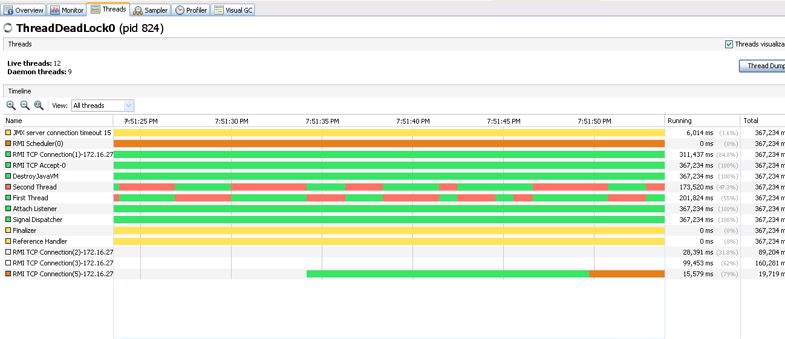
Threads status in VisualVM

Slide 69
Improving lock performance
Below are various approaches which can be applied during code development/design, to improve lock performance.
Lock splitting
Use built in concurrent data structures
Protect data instead of code
Lock scope reduction.

Slide 70
Jstack tool purpose
‘jstack’ is an effective command line tool to capture thread dumps, available with JDK
How to use?
jstack -l <pid> > <file-path>
pid: is the Process Id of the application, whose thread dump should be captured
file-path: is the file path where thread dump will be written in to.
Example:
jstack -l 37320 > C:/threadDump.txt

Slide 71
Tuning JIT Compiler
Java virtual machines (JVM) use Just-In-Time (JIT) compilers to compile Java byte codes into native instructions during server run time. A JIT compiler is a platform-specific compiler that generates machine instructions for each method as needed. These compilers can affect startup or runtime performance.

Slide 72
What optimizations JIT can perform?
Below are optimizations, which JIT can perform.
Inline methods - instead of calling method on an instance of the object it copies the method to caller code. The hot methods should be located as close to the caller as possible to prevent any overhead.
Eliminate locks if monitor is not reachable from other threads
Replace interface with direct method calls for method implemented only once to eliminate calling of virtual functions overhead
Join adjacent synchronized blocks on the same object
Eliminate dead code
Drop memory write for non-volatile variables
Remove prechecking NullPointerException and IndexOutOfBoundsException

Slide 73
Tuning JIT Compiler
Lets check how we can Monitor and Tune JIT Compiler
Java Launcher Codecache Option
Measuring Codecache Usage
Constraining the Codecache Size
Reducing Compilations
Reducing Compiled Method Sizes
NOTE: How to check all JVM options?
java -XX:+PrintFlagsFinal | more
java -XX:+PrintFlagsFinal | findstr GC

Slide 74
How JIT Can improve performance?
JVM generates native code and stores it in a memory area called the codecache. JIT uses major chunk of codecache, how can we control below.
Constrain the amount of codecache available to the JIT.
Tune the JIT to compile fewer methods.
Tune the JIT to generate less code per method.
All are –XX options, for example,
-XX:InitialCodeCacheSize=32m
InitialCodeCacheSize - Initial code cache size (in bytes)
ReservedCodeCacheSize - Reserved code cache size (in bytes) - maximum code cache size
CodeCacheExpansionSize - Code cache expansion size (in bytes)

Slide 75
JIT-Code Cache Flush Options
ExitOnFullCodeCache - Exit the JVM if the codecache fills
UseCodeCacheFlushing - Attempt to sweep the codecache before shutting off compiler
MinCodeCacheFlushingInterval- Minimum number of seconds between codecache sweeping sessions
CodeCacheMinimumFreeSpace - When less than the specified amount of space remains, stop compiling.

Slide 76
JIT-Compilation Limit Options
MaxInlineLevel - Maximum number of nested calls that are inlined
MaxInlineSize - Maximum bytecode size of a method to be inlined
MinInliningThreshold - Minimum invocation count a method needs to have to be inlined
InlineSynchronizedMethods - Inline synchronized methods

Slide 77
JIT-Diagnostic Options
PrintFlagsFinal - Print all JVM options
PrintCodeCache - Print the code cache memory usage when exiting
PrintCodeCacheOnCompilation - Print the code cache memory usage each time a method is compiled

Slide 78
Diff. b/n synchronized and concurrent collections
Both methods suggest that the Java Virtual Machine expend effort toward recycling unused objects in order to make the memory they currently occupy available for quick reuse. When control returns from the method call, the Java Virtual Machine has made a best effort to reclaim space from all discarded objects.
The System.gc() is a static method so it's a little bit more convenient to use. The call System.gc() is effectively equivalent to the call:
Runtime.getRuntime().gc();

Slide 79
Diff. b/n System.gc() and Runtime.getRuntime.gc()
Both methods suggest that the Java Virtual Machine expend effort toward recycling unused objects in order to make the memory they currently occupy available for quick reuse. When control returns from the method call, the Java Virtual Machine has made a best effort to reclaim space from all discarded objects.
The System.gc() is a static method so it's a little bit more convenient to use. The call System.gc() is effectively equivalent to the call:
Runtime.getRuntime().gc();

Slide 80
Diff. b/n Client and Server JVM
To choose between server and client mode we can have client mode for small programs that are not executed for a longer period and server mode otherwise. The startup of the JVM might be slower in server mode and the runtime memory footprint also will be larger. Client mode starts JVM in quicker time and memory footprint is also lesser. This is because client mode does not try to optimize many code blocks as the server mode does. Therefore the shorter startup time and less memory usage.
So what is the special optimization done by server mode? One example is in lining of virtual method invocations wherever it is used. This is done by adaptive compilation. One more thing done by server mode is, it does not give back the memory acquired back to the OS till the execution is complete. But in case of client mode if a certain block of memory is left unused it may give back to the OS during the execution of the program. Initial options like InitialHeapSize and MaxHeapSize are taken as large numbers in server mode on launch in comparison with client mode.

Slide 81
HotSpot JVM and other Flavours

Slide 82
HotSpot JVM and other Flavours
By Default JVM is launched in client mode, when java command is invoked.
Launch JVM in Server mode, as below.
java -server ClassName
They are essentially two different compilers (JITs) interfacing to the same runtime system. The client system is optimal for applications which need fast startup times or small footprints, the server system is optimal for applications where the overall performance is most important. In general the client system is better suited for interactive applications such as GUIs

Slide 83
Purpose of jstatd?

Slide 84
Miscellaneous
-XX:+HeapDumpOnOutOfMemoryError writes heap dump on OutOfMemoryError (recommended)
-XX:+HeapDumpOnCtrlBreak writes heap dump together with thread dump on CTRL+BREAK
-Xmn[size]: Size of young generation heap space.
Applications with emphasis on performance tend to use -Xmn to size the young generation, because it combines the use of -XX:MaxNewSize and -XX:NewSize and almost always explicitly sets -XX:PermSize and -XX:MaxPermSize to the same value.
Heap Size can be specified in GB, just by suffixing with g
Log4j supports Asynchronous Logging
https://logging.apache.org/log4j/log4j-2.3/manual/async.html
AWS supports Heap and GC Tuning on the instances

Slide 85
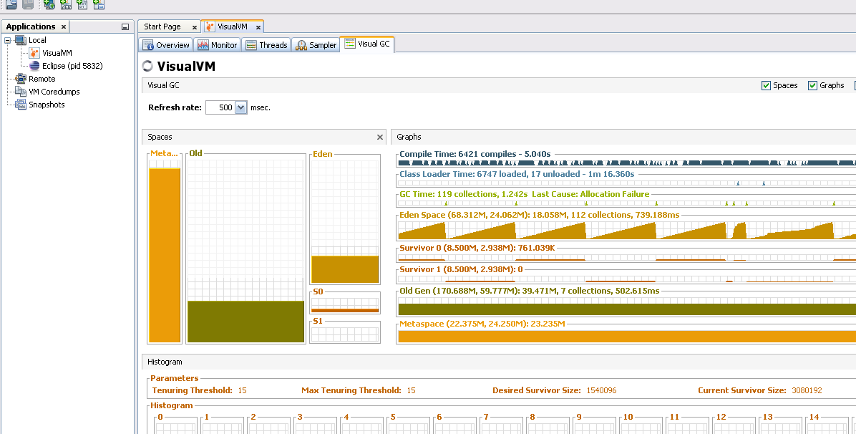
VisualVM
Memory reclaimed thru GC run
No. of GC runs
Maximum Capacity
Current Capacity
Total time GC has run

